Slide 1
Microsoft sql server (mssql)
Presented By:Er.Sudan Prajapati

Slide 2
Introduction
Microsoft SQL Server is a relational database management system developed by Microsoft.
As a database, it is a software product whose primary function is to store and retrieve data as requested by other software applications, be it those on the same computer or those running on another computer across a network (including the Internet).
There are at least a dozen different editions of Microsoft SQL Server aimed at different audiences and for workloads ranging from small single-machine applications to large Internet-facing applications with many concurrent users.
Its primary query languages are T-SQL and ANSI SQL.

Slide 3
How to install SQL Server
Go to your folder in machine where you have SQL Server Setup files and file the setup.exe file this is executable file that is used to install SQL Server for you.
Do right click on this file and select Run as administrator option from the appeared context menu as mentioned below in Screenshot.

Slide 4
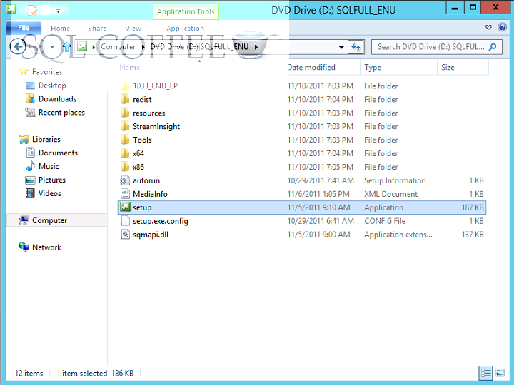
Step-by-step procedure to install SQL Server

Slide 5
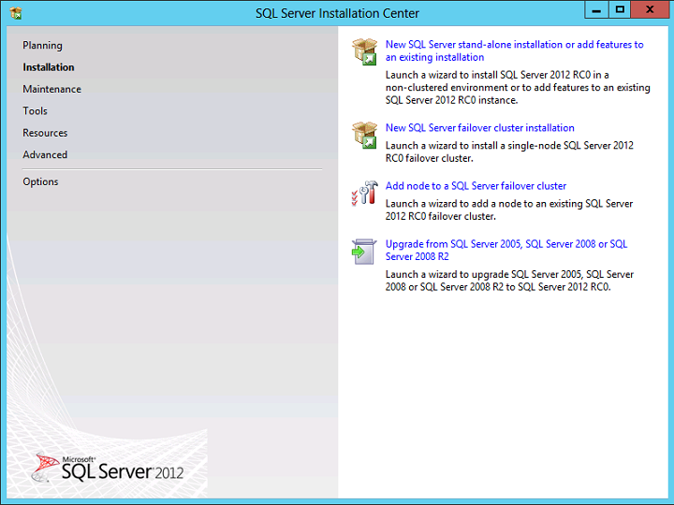
Step-by-step procedure to install SQL Server

Slide 6
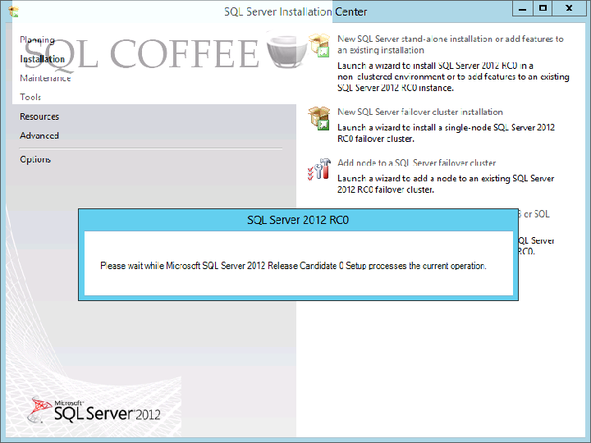
Step-by-step procedure to install SQL Server

Slide 7
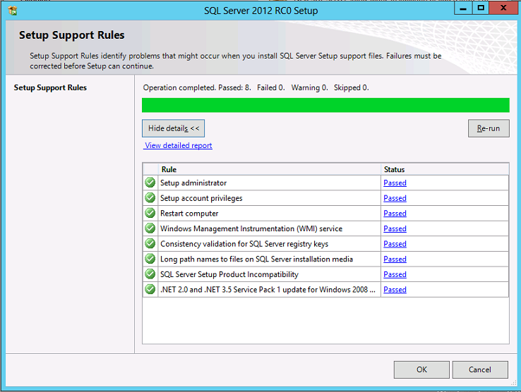
Step-by-step procedure to install SQL Server

Slide 8
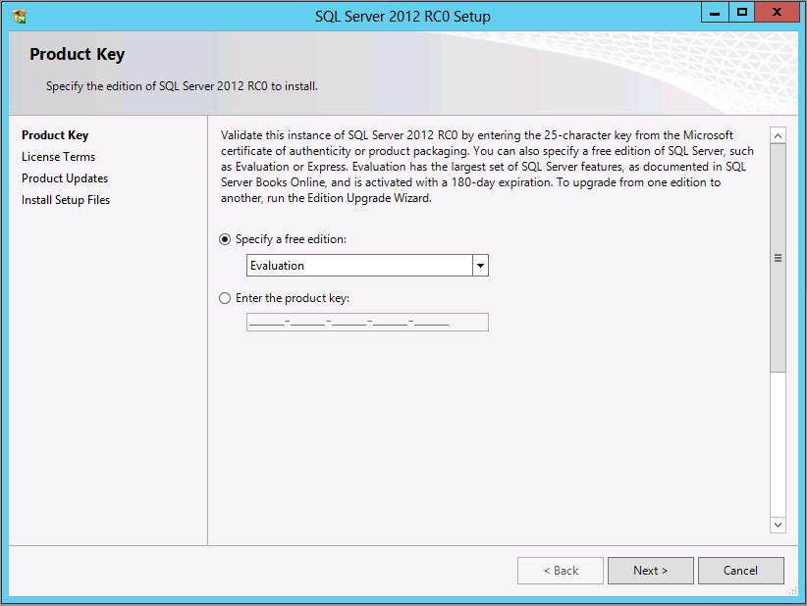
Step-by-step procedure to install SQL Server

Slide 9
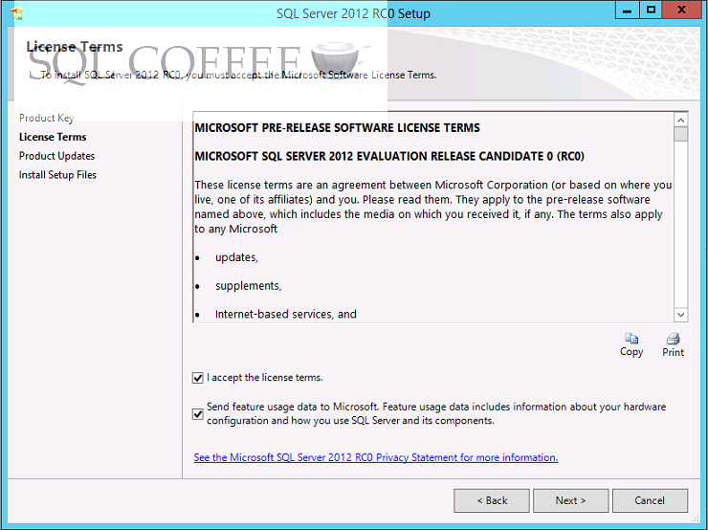
Step-by-step procedure to install SQL Server

Slide 10
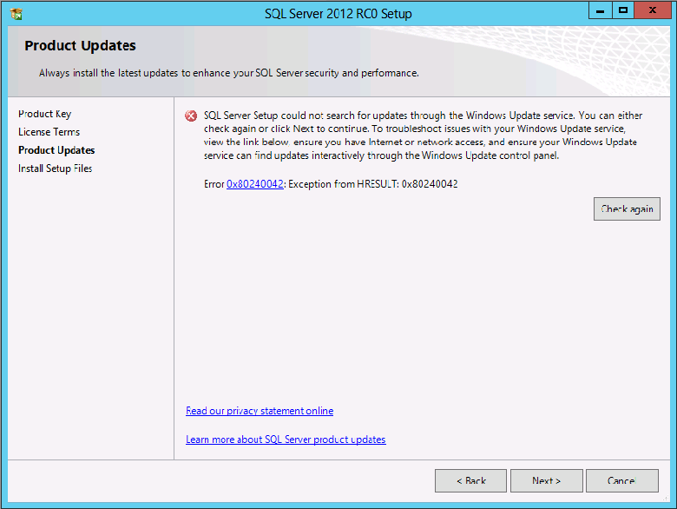
Step-by-step procedure to install SQL Server

Slide 11
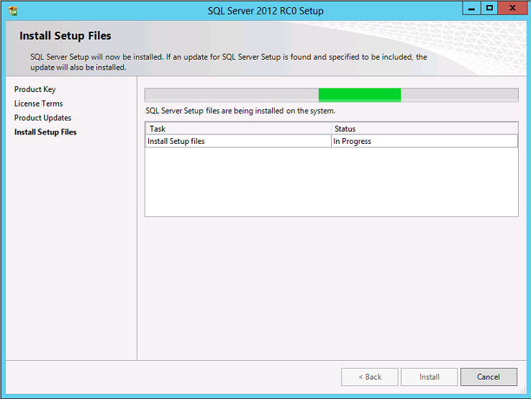
Step-by-step procedure to install SQL Server

Slide 12
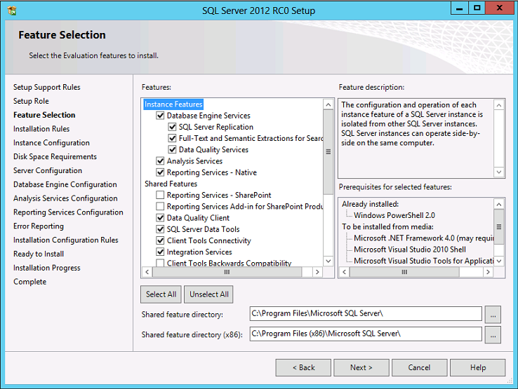
Step-by-step procedure to install SQL Server

Slide 13
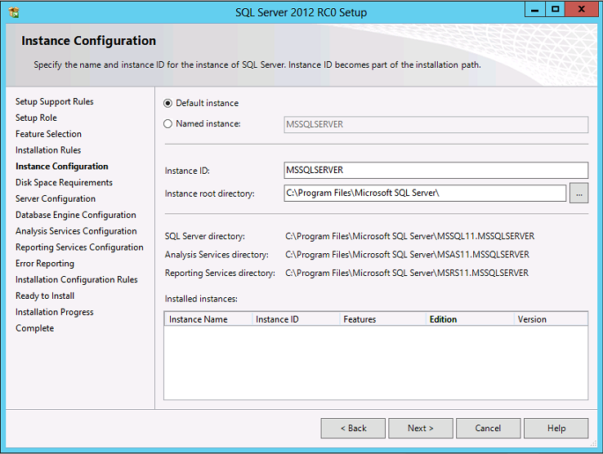
Step-by-step procedure to install SQL Server

Slide 14
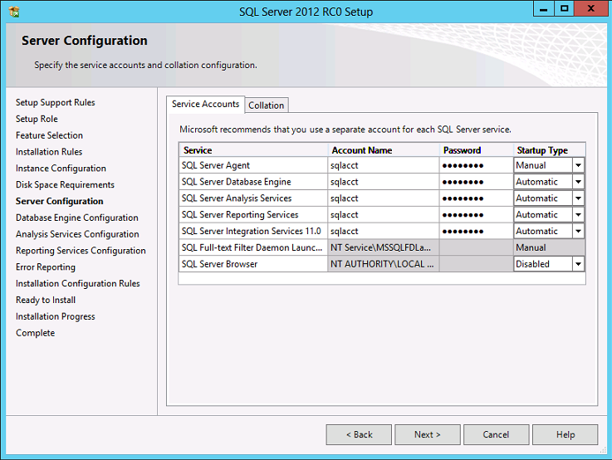
Step-by-step procedure to install SQL Server

Slide 15
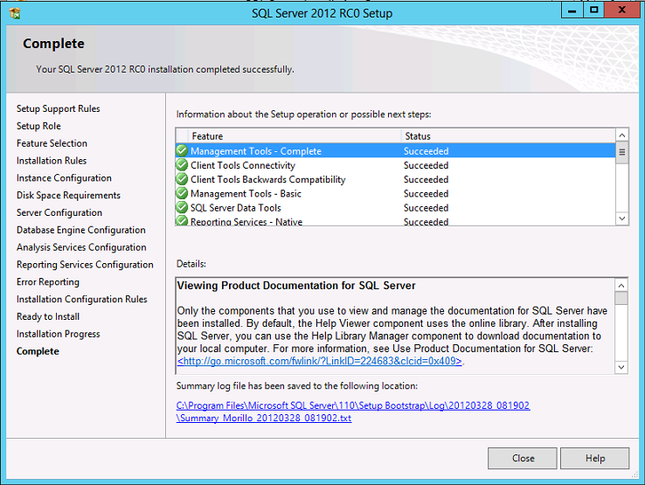
Step-by-step procedure to install SQL Server

Slide 16
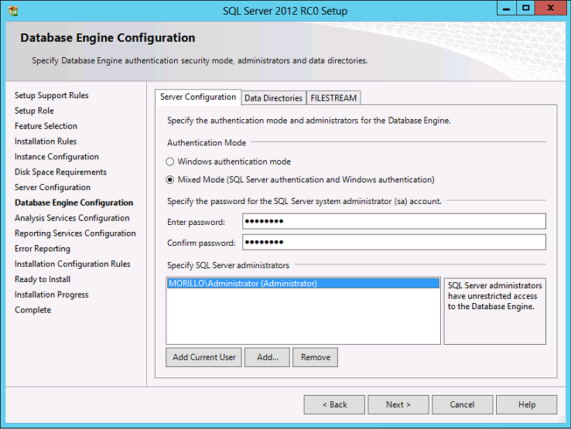
Step-by-step procedure to install SQL Server

